Slide 1
Welcome to Middle School Admissions

Slide 2
How do you apply?
October
Access your child’s personalized middle school application in MySchools*
MySchools is both an online directory and your child’s personalized application. It will include as options every middle school that your child is eligible to attend
December 3
Add up to 12 programs to the application and place them in your true order of preference
April
1 offer
Notes:
Every fifth grader must apply to middle school
You will receive clear instructions on how to access your MySchools account in late October.
You should rank programs in your true order of preference.
It is important to put the school you most want their child to attend 1st on the application, your second choices 2nd , and so on.
You will receive a notification letter in April with one middle school offer.

Slide 3
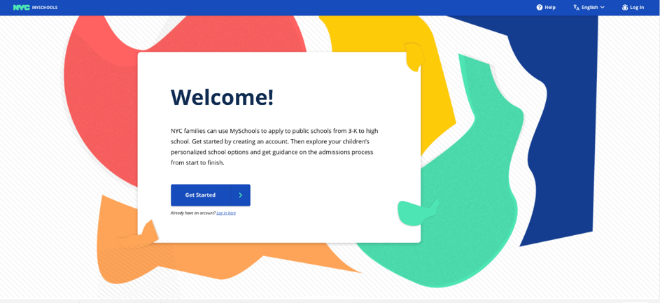
How do you apply? (continued)
This fall, parents can complete their child’s middle school application online at myschools.nyc.
Parents create an account with their personal email addresses.
To add a student to their account, they will need:
Student ID (OSIS)
Account Creation Code (invitation letters mailed home; also can be received at current school)
The online application will be mobile device friendly, and available in the nine languages* translated by the NYCDOE (Arabic, Bengali, Chinese, French, Haitian Creole, Korean, Russian, Spanish and Urdu)
Notes:
You will be able to access myschools.nyc at the end of October.
You can access the application on a computer, tablet or mobile device.
In late October, you will get a MySchools invitation letter in the mail with you child’s personal account creation code.
If you do not receive this letter, or need a replacement copy, you can get one from our school’s middle school liaison.
It’s best to use your personal email to create an account. Instructions on how to create an account will be on your invitation letter.

Slide 4
Access and review your child’s application
When you access the application, be sure to review all information about your child:
Make sure all personal information, including your child’s address, is correct.
Make sure your child’s academic record is accurate.
Access and review your child’s application
Need help?
Talk to your school counselor
Visit a Family Welcome Center
Call us at 718-935-2009
If you see anything on your application that is inaccurate, contact your child’s current elementary school as soon as possible.
Notes:
Your student’s middle school applications will be personalized and include their address and 4th grade academic record:
Final 4th grade ELA, Math, Science, and Social Studies grades
NYS ELA and Math scores
Attendance and lateness
Academic and personal behavior scores
Parents should review their application and make sure all information is correct.
If you see any incorrect information, please let us know.
Families can also get help from a Family Welcome Center or by calling 718-935-2009

Slide 5
What schools can I apply to?
When you log into MySchools, you will have a personalized list of schools to choose from. All the DOE public schools that your child can apply to will be included:
Your Zoned School
Learn if you have a zoned middle school at schools.nyc.gov/Find-a-School
(Not all students have a zoned middle school)
District Schools
Open to all students who live and/or attend public elementary school in the district.
If your child lives in one district and goes to school in another, they are eligible to apply to district schools in both districts.
Boroughwide Schools
Citywide Schools
Charter schools have a separate admissions process and are not part of the middle school application.
Notes:
On MySchools, you will see all the schools your child is eligible to apply to.
All DOE middle schools are part of the application process.
Students are eligible to apply to middle schools in District [state your school’s district]. If you are zoned to a different district, you are also eligible to apply to middle schools in that district.
If you are interested, you should reach out to them directly.

Slide 6
Choose schools for your child’s application
Explore your middle school options in MySchools and add programs to your application. How do you choose where to apply? Consider the following:
Travel
How will your child get from home to school each day?
How long is the commute?
Visiting the school is a good way to see what this trip is like!
Programs and courses offered
Are there specific academic courses, clubs, activities, or sports that appeal to you and your child?
School size
How many students go to the school?
Mission and vision
What makes the school special?
Notes:
You can should explore school options by using the MS Directory and MySchools
The MS Directory is also available online on the DOE website.

Slide 7
How do students get middle school offers?
Choices on the Application
The programs you include in your child’s application AND the order in which they are placed.
Admissions Priorities
The order in which groups of applicants are considered
Admissions Methods
How students are matched to seats.
Seat Availability
The number of seats available for applicants.
Notes:
Students will receive one offer from their MS Application.
These four factors determine what match a student will receive

Slide 8
Complete your child’s application
Add up to 12 program choices to your child’s application. If a school has multiple programs, you may apply to one program, or more than one program at that school.
Be sure to place them into your true order of preference, with your favorite program as #1.
Submit the application by December 3, 2018.
TIP | After adding your favorite programs, consider adding more choices to your application.
TIP | Rank programs you’d prefer to your zoned or continuing school ahead of your zoned or continuing school.
Remember, if you do not get an offer to a program from your application, you will be matched to a program with availability in your district.
Notes:
The biggest factor in what school your child gets an offer to are the choices on your MS Application
Some schools have multiple programs. Think of these programs as “doorways” through which schools accept students; these programs may have different admissions methods and priorities

Slide 9
Admissions Priorities
At some schools, students are considered in groups. All students in the first priority group will be considered first. If seats are available, students in the second priority group will be considered next, and so on.
Admissions Priorities
Priority to students and residents of the District
Then to students and residents of Brooklyn
This means that All students who live or go to school in the District that list this program on their application will be considered before other Brooklyn students who list this program on their application.
Notes:
Admissions Priorities determine the order that applicants are considered for placement.
Admissions Priorities can be based on where a child lives or goes to school, if they signed in at a school fair or open house, and if they are a continuing student at a K-8 school.
If a program has admissions priorities, they are listed in the middle school directory and in MySchools

Slide 10
Admissions Methods
An admissions method is the way a school program considers and matches with applicants. These admissions methods do not see any academic information:
Zoned
Based on address
Open
Random Selection
Limited Unscreened
Random selection, but students will move into a higher priority group by signing in at a school event
TIP | If applying to a “Limited Unscreened” program, visit and sign in!
Notes:
An Admissions Method is the way a school program considers and matches with applicants.
Programs that use these Admissions Methods CAN’T see applicants’ academic information.
Families who are interested in Limited Unscreened programs should visit these school’s table at a fair and sign in, or visit these schools at an open house.

Slide 11
Admissions Methods (continued)
An admissions method is the way a school program considers and matches with applicants. These admissions methods do see academic information:
Screened
School ranks students based on fourth-grade attendance, state tests, and grades. Additional requirements may exist
Screened for Language
Based on students’ English language skills
Composite Score
Students are admitted based on a score that’s calculated using fourth grade report cards, state ELA and math exams, attendance, and behavior
Notes:
Programs that use these Admissions Methods CAN see applicants’ academic information.
Some screened programs require an onsite assessment or interview.
Families should contact screened schools directly for information on how they evaluate applicants

Slide 12
Selection Criteria
Programs with Screened, Screened: Language, or Composite Score Admissions Methods use specific Selection Criteria to admit students.
For most up-to-date information, please contact middle schools directly.
Notes:
The middle school directory list the selection criteria for every middle school program
Families should contact screened schools directly for information on how they consider applicants for admission
Middle school can provide families with their admissions rubric upon request

Slide 13
Key Dates
Fall | Attend open houses and middle school fairs Contact schools directly to learn when to visit.
Late October | Access the middle school application in MySchools
December 3 | Apply to middle school by December 3, 2018
April | Get your child’s middle school offer
May | Appeals Round – Only for seats that remain after the main round.
Key dates
Notes:
In the appeals round students can only be matched to seats that remain after the main round.

Slide 14
Resources
Learn more
Get help with your application
2019 NYC Middle School Directory |schools.nyc.gov/Middle
Middle school admissions email newsletter |schools.nyc.gov/Connect
Your zoned school |schools.nyc.gov/Find-a-School
Your school counselor
Visit a Family Welcome Center |schools.nyc.gov/WelcomeCenters
Office of Student Enrollment
|718-935-2009
Notes:
Families should sign up to receive email newsletter
Please let us know if you need help with your application.
For additional assistance, you can visit a Family welcome Center or call the enrollment helpdesk

